Slide 1
Customer Booking Prediction Using Random Forest- British Airways
A Comprehensive Analysis of Customer Behavior and Model Performance
Presented by : Gurleen Kaur Bali

Slide 2
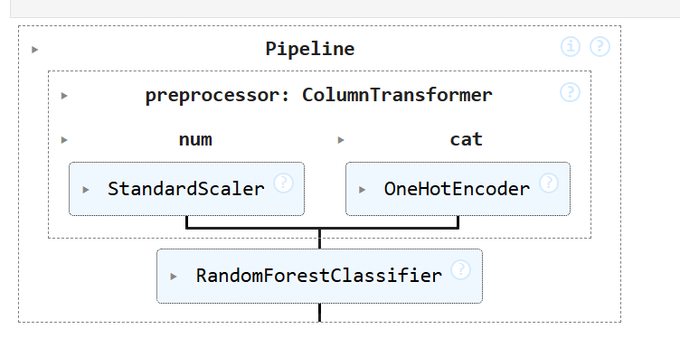
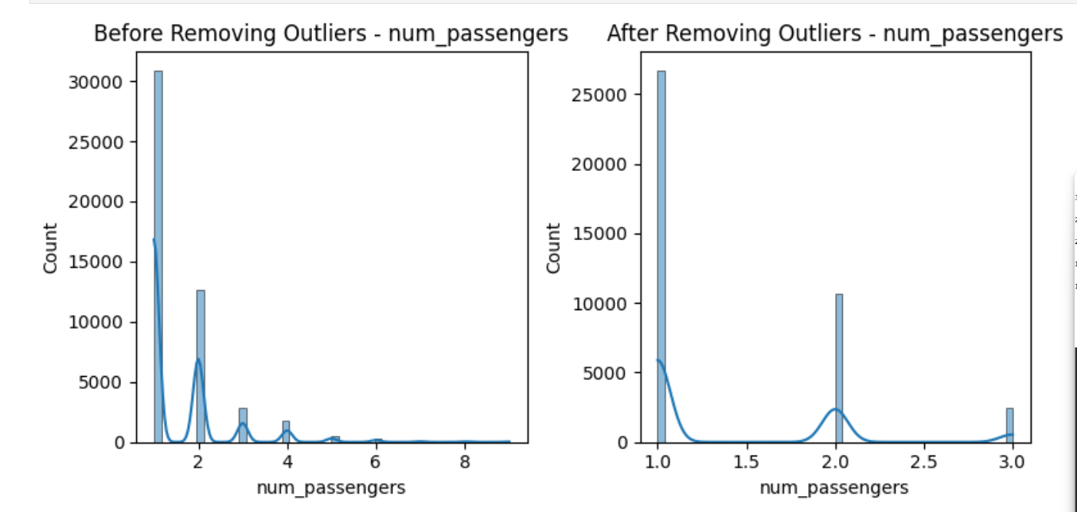
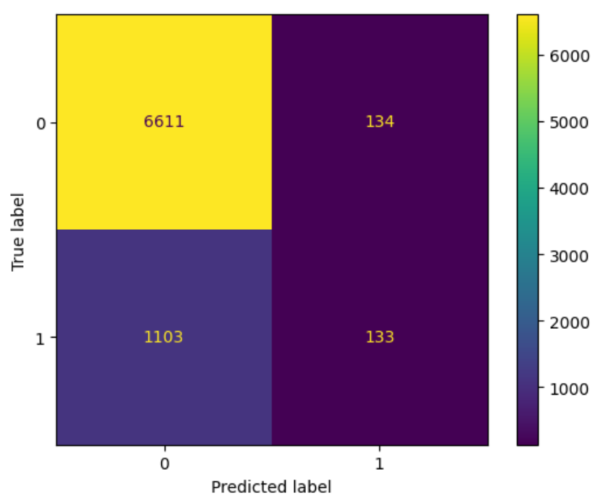
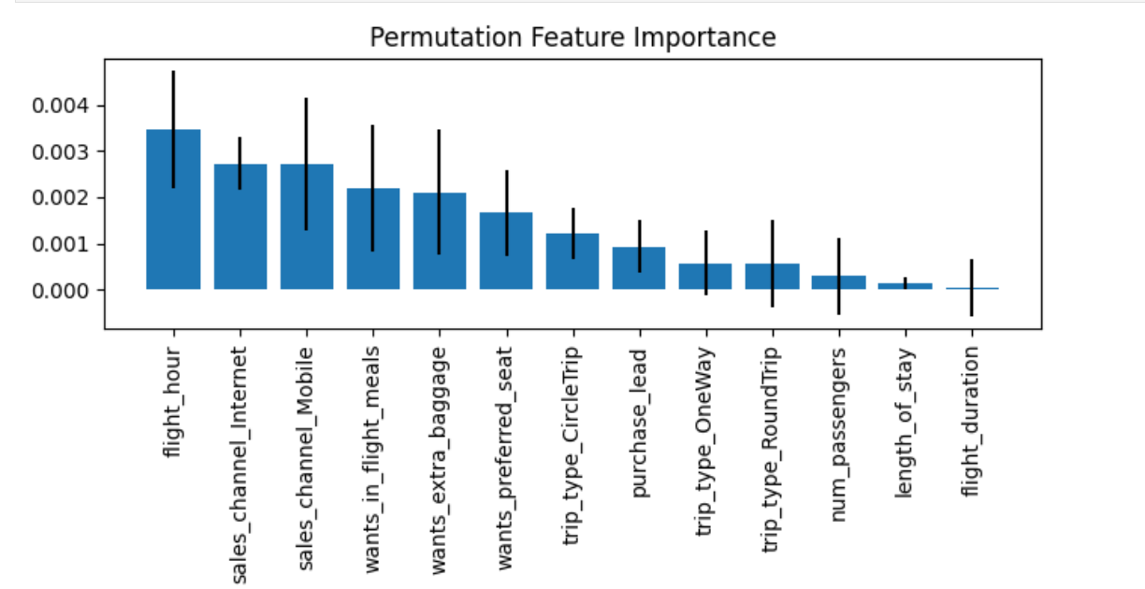
Data Preprocessing
Model Building
Random Forest
Outliers removal
Performance Evaluation
Feature Importance

